Slide 1

Reddit Project
Alfred wei

Slide 2
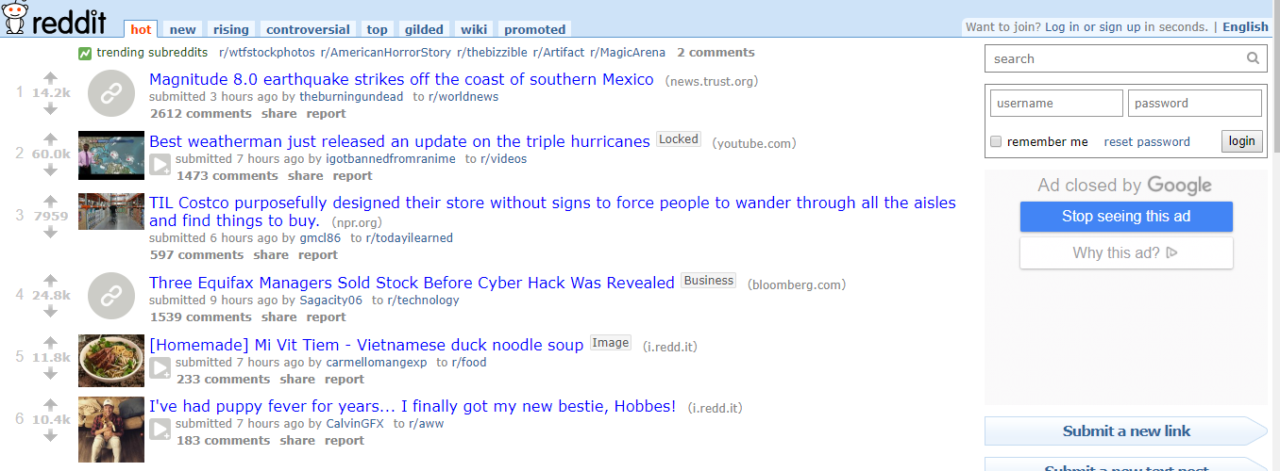
Reddit website

Slide 3
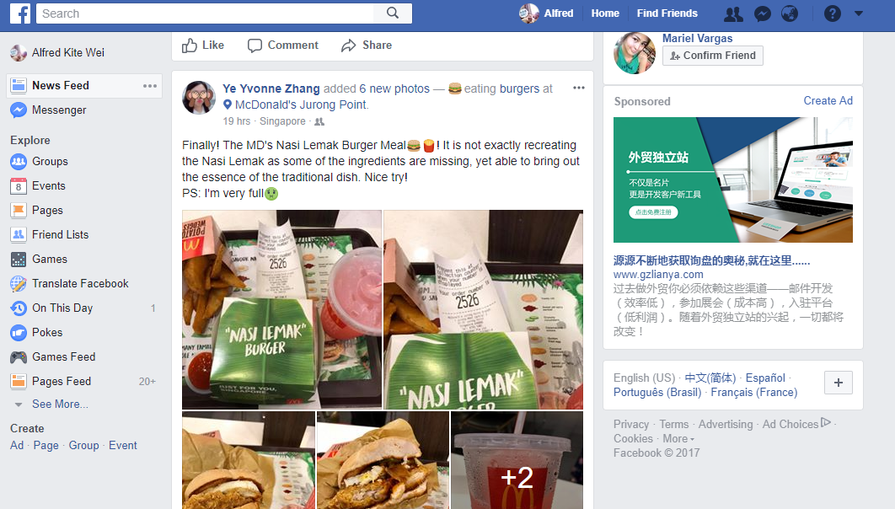
Facebook

Slide 4

Project Demo

Slide 5
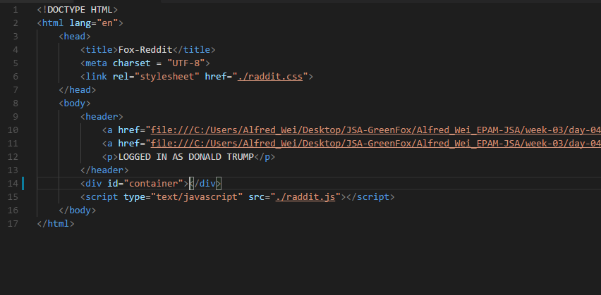
HTML code

Slide 6
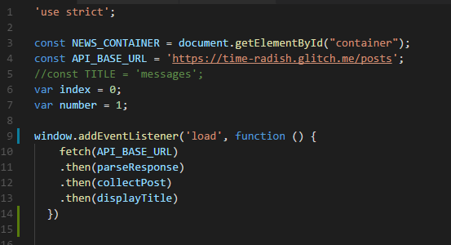
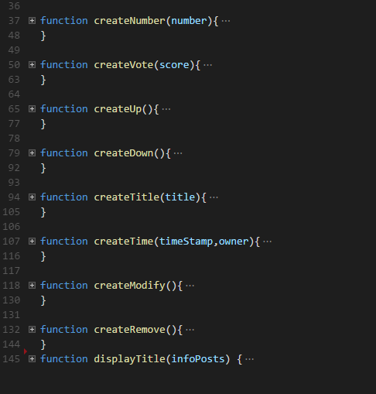
JS code

Slide 7
Improvements
Vote
Modify & Remove

Slide 8
THANK YOU

Slide 9
Any Questions ?

